Slide 1
Feature-based attention & reward probability: An SSVEP Study

Slide 2
The initial idea
Rewards influence selective attention (Chelazzi et al., 2013; Anderson 2016; Failing & Theeuwes, 2017)
Priority/saliency of stimuli related to high rewards is increased
Priority/saliency of stimuli related to low rewards is decreased
Changes in the activity of neurons in the VC (Roelfsema et al., 2010)
These effects remain even if the possibility of earning rewards is no longer present (value-driven attentional capture; Anderson & Yantis, 2011)
Most of the work in this domain has used visual search and cueing paradigms
Linking features to different reward magnitudes/probabilities
Transient attention
Spatial and feature-based confounded
Hard to look into simultaneous allocation of attention to multiple locations/features

Slide 3
The initial idea
SSVEPs - Oscillatory responses of the VC to flickering stimulation (Norcia et al., 2015)
Frequency tagging
Good SNR
Amplitude increased by spatial and feature-based visual attention (Andersen et al., 2012)
Use SSVEPs to asses the simultaneous allocation of feature-based attention towards stimuli linked to different reward schedules
Advantages:
Focus on feature-based attention without the spatial confound
Sustained vs. transient attention
Allows to investigate simultaneous neural facilitation vs. suppression of different features

Slide 4
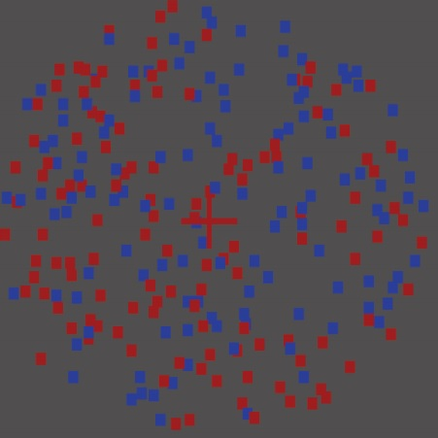
RDK Task
Andersen & Mueller, 2011, PNAS

Slide 5
RDK task
Dots in two colors (125/125)
Flickering at 10 & 12Hz
Random motions
Trials last for 3.25s
390 frames at 120Hz
75% of dots move coherently 240 times over 200 trials
Trials: no coherent motion, one, two, or three
To-be-attended color is cued by a sound at the beginning of each trial (“blue” or “red”)
Participants need to detect the coherent motion (press SPACE)
Auditory feedback:
Wrong
Missed motion
Correct

Slide 6
Design
PRACTICE
€
5 Blocks of 40 trials
BASELINE
4 Blocks of 50 trials
ACQUISITION
4 Blocks of 50 trials
EXTINCTION
4 Blocks of 50 trials

Slide 7
Analysis
26 subjects in total (for 13 red related to high reward)
Good recordings, enough epochs retained
Hit rate > 60% across all trials
We had to throw away a large number of subjects – the task is very difficult
Only analyzed the behavior of subjects with good EEG recordings
SSVEPs: Only trials in which there were no movements

Slide 8
Behavioral data

Slide 9
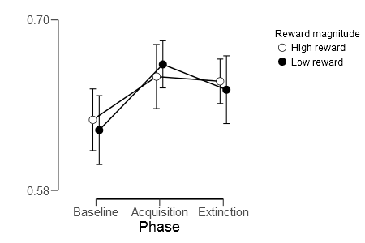
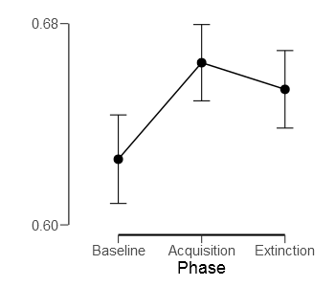
Hit Rates
Phase (Baseline, Acquisition & Extinction) & Reward (High & Low)
Notes:
Explain Bayesian model comparison – two factors = 5 models

Slide 10
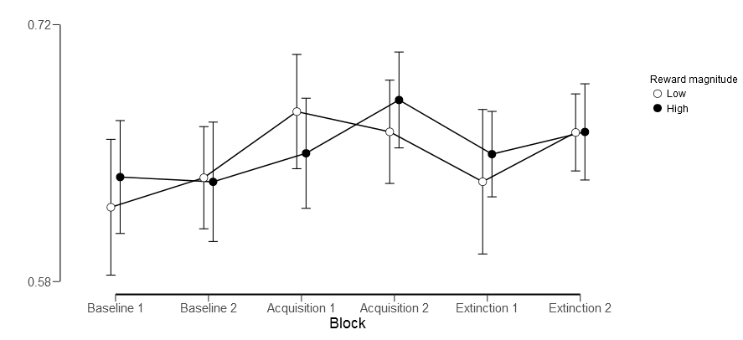
Hit Rates
Splitting blocks – excluding the possibility of practice effects

Slide 11
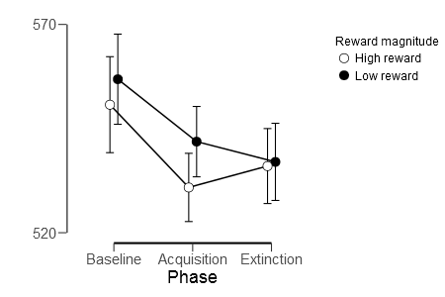
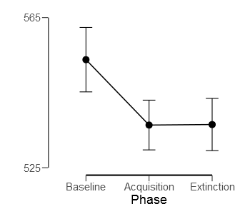
Reaction times
Phase (Baseline, Acquisition & Extinction) & Reward (High & Low)

Slide 12
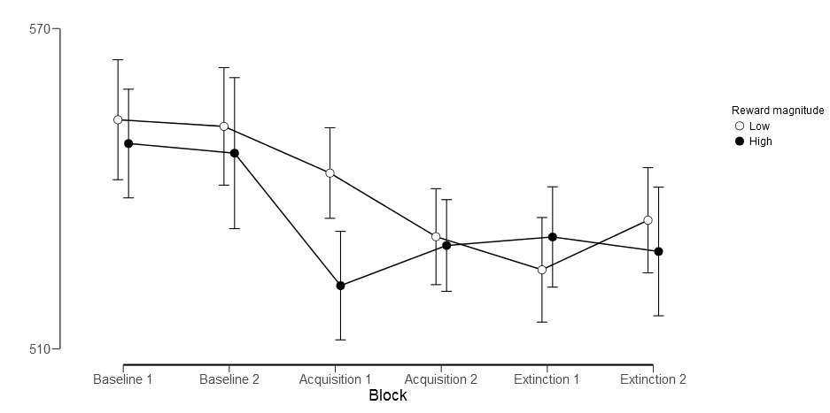
Reaction times
Splitting blocks – excluding the possibility of practice effects

Slide 13
SSVEP data

Slide 14
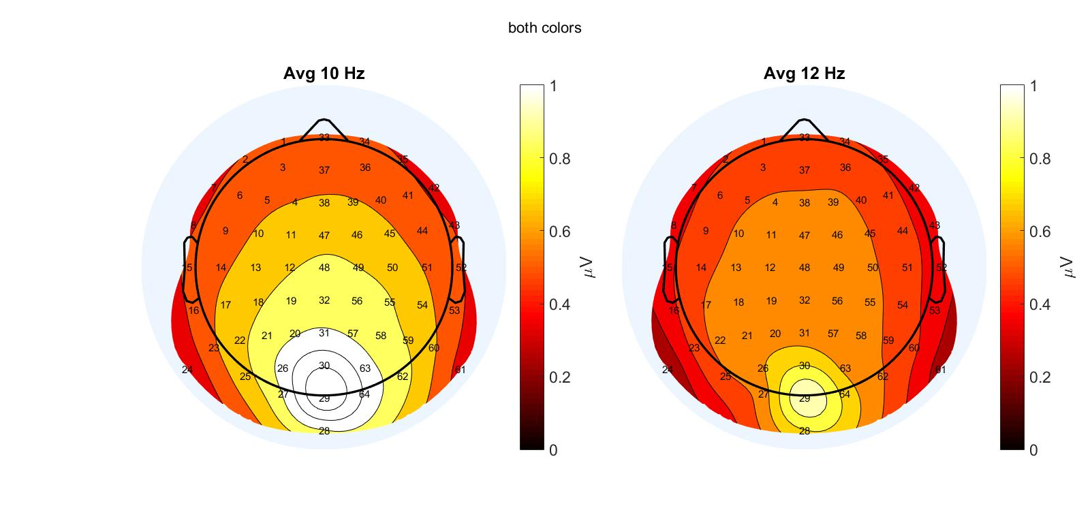
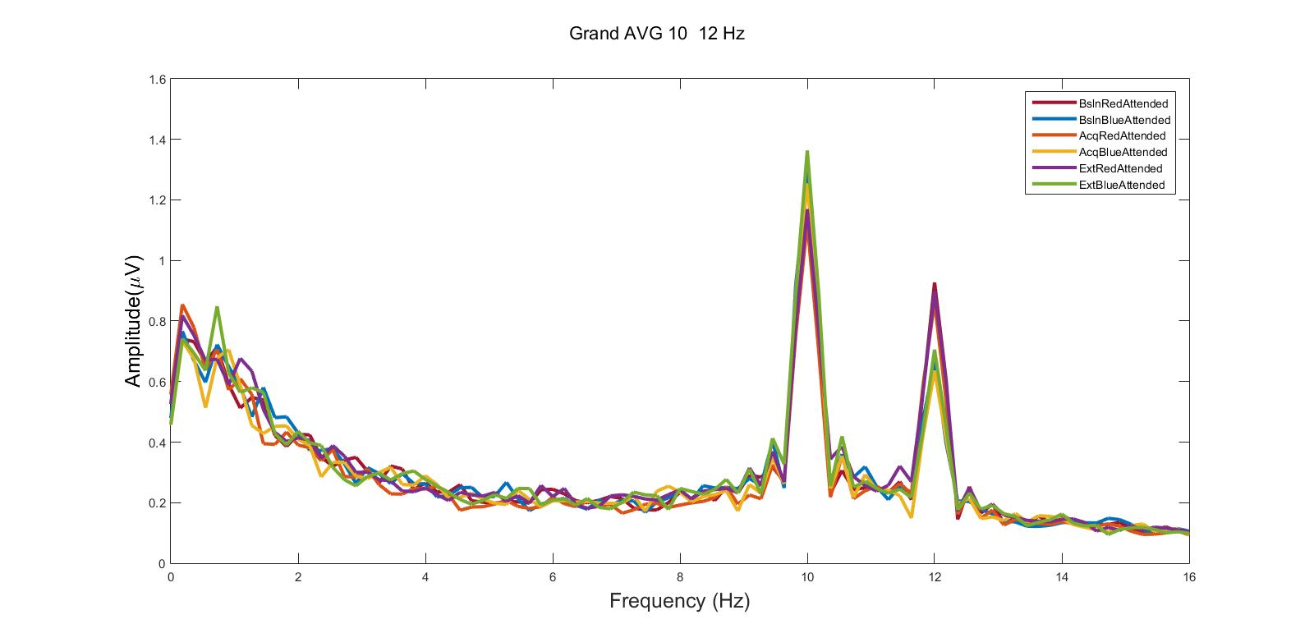
Topography & spectra
Notes:
Not the difference in amplitude for the 10 vs. 12 HZ! This is why we normalize the amplitudes by dividing the amplitude for every subject in each condition for each of the two frequencies by the average amplitude of that subject for that frequency.

Slide 15
Full model
Phase (Baseline, Acquisition & Extinction) & Reward (High & Low) (Color) & Attention (Attended & Unattended)
Notes:
Not ideal to put reward into the model because this factor is only relevant in the acquisition phase – see next slide

Slide 16
Full model
Phase (Baseline, Acquisition & Extinction)
Attention (Attended & Unattended)

Slide 17
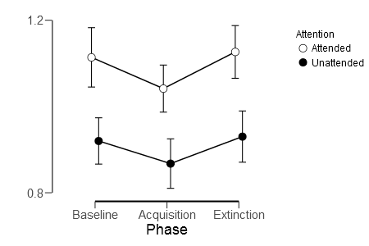
Main effect of Attention
On each trial we record the frequency of both colors – the attended one and the unattended one

Slide 18
Main effect of Phase

Slide 19
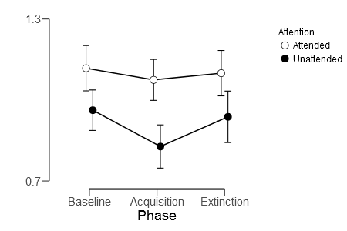
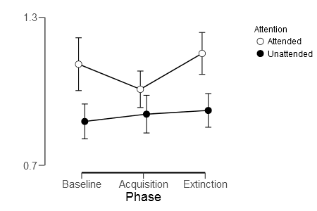
T-tests for the difference between phases
Reward magnitude: High reward
Reward magnitude: Low reward

Slide 20
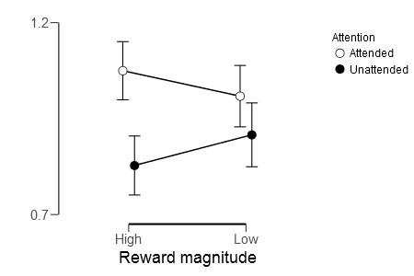
Acquisition phase

Slide 21
Conclusions
Strong replication of the attention effect – the paradigm works
Strong behavioral effect of the reward block which remains in extinction
The SSVEP amplitude reduced in the rewarded block and goes back to baseline in extinction
There is suggestive evidence for a reduction in the amplitude for the low rewarded color in the rewarded block

Slide 22
Interpretation
Spatial vs. feature-based selective attention (this paradigm is not confounded by spatial effects)
This is a useful method for simultaneously looking at allocation of attention over stimuli related to different reward schedules
The dominant idea is that effects of reward on selective attention operates via
Increasing the saliency of features/locations related to high rewards
Reducing the saliency of features/locations related to low rewards
Our results partially confirm this idea
Maybe we don’t see the facilitation because of the task difficulty?
Interesting decoupling between behavior and SSVEP in extinction
Future work
Stronger reward manipulation + a longer acquisition phase
Making the task less difficult

Slide 23
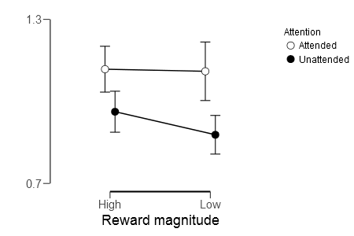
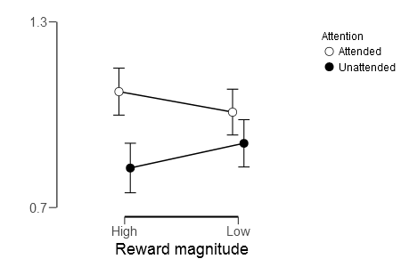
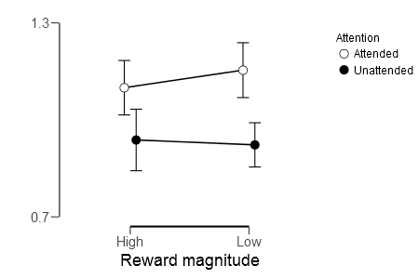
All phases
Baseline
Acquisition
Extinction

